Slide 1
Predicting Parkinson With Handwriting
By Joshua Wilson

Slide 2
What's new / goals
Data exploration to help visualize the data
Collected new data set
Found more analysis opportunities
Working on analysing the data
Run further analysis on the data such as with an ROC ,PCA
Work on feature extraction for the data such as getting the size or shape
Work on ML such as K means, Random Forest, and neural networks

Slide 3
Background
Parkinson's disease (PD) is a neurodegenerative disorder that affects multiple aspects of motor and non-motor function, including handwriting. Handwriting can be used as a measure of motor impairment in PD and is often used to assess the progression of the disease.
Studies have shown that handwriting in PD patients is characterized by slow and small movements, reduced writing speed and legibility, increased tremors, and changes in pressure, size, and spacing of letters. Some studies have also reported changes in the overall organizational structure of writing and a decrease in the size of personal signature.
In advanced stages of PD, the impairment of handwriting can lead to difficulty with daily activities such as writing checks and signing documents.
This project will be unique as it can help classify the severity based on the drawings

Slide 4
In a 2017 study researches determined there was a link between different attributes in writing such as size force and other factors that can be used to determine the severity of Parkinson's.
Handwriting training in Parkinson’s disease: A trade-off between size, speed and fluency
Another 2017 study should that using these factors we can determine which ones have a higher chance of Parkinsons
Handwriting Analysis in Parkinson's Disease: Current Status and Future Directions
Another 2017 study helped indict the link between pen pressure and speed when it relates to this test and diagnosing Parkinson's.

Slide 5
Problem
There are 500,000 people in the US diagnosed with Parkinson's, but experts believe it very under diagnosed.
Parkinson's is a disease that affects mental abilities in patients but one of its main traits is its effects on people's mobility.
A promising test to help determine the chances of Parkinsons and the stage they may be at.

Slide 6
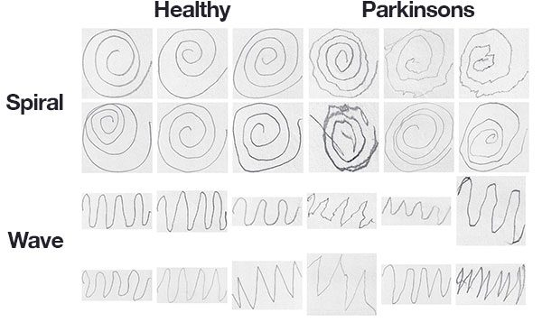
Spiral Test
The spiral test is used to diagnose Parkinson's disease because it is able to detect the characteristic tremors and movement problems that are associated with the disease. By observing a person's ability to draw a spiral on a piece of paper, doctors can gain insight into the motor skills and coordination affected by Parkinson's.

Slide 7
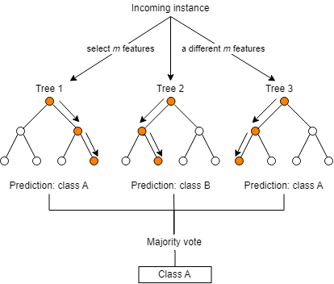
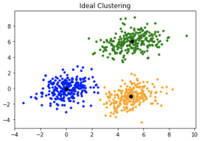
Analysis
Using Classification such as K - Nearest Neighbors I’ll be able to predict certain qualities from the image data such as consistency in the lines.
Other analysis will be done are Random forest and deep learning for comparing which gives the best classification

Slide 8
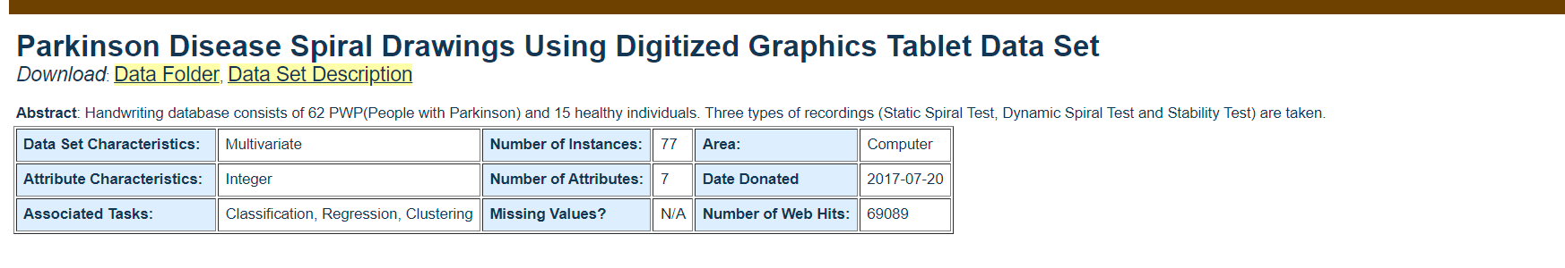
Dataset
The Dataset I will be using is the UCI image data set on Parkinson Drawings of Spirals
This data is set up into to two classes patients without Parkinson's and those with
The data set is made up of labeled graphed images

Slide 9
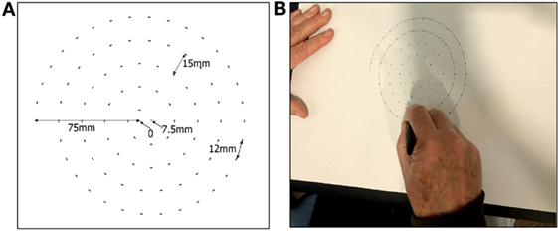
Dataset 2
Dataset 2 is a set of data that helps determine other factors involved in the drawing that can help determine it gives such as pressure and speed.
(Zham et al., 2017)

Slide 10
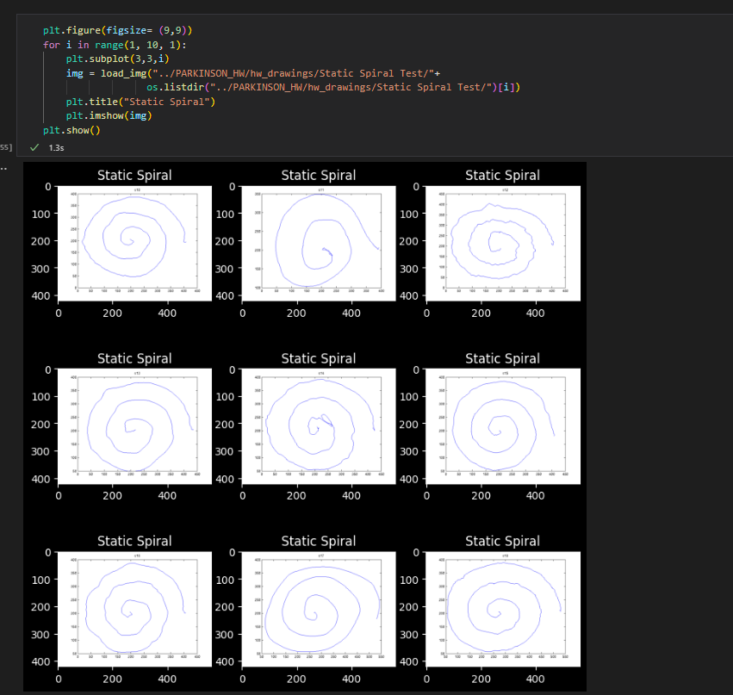
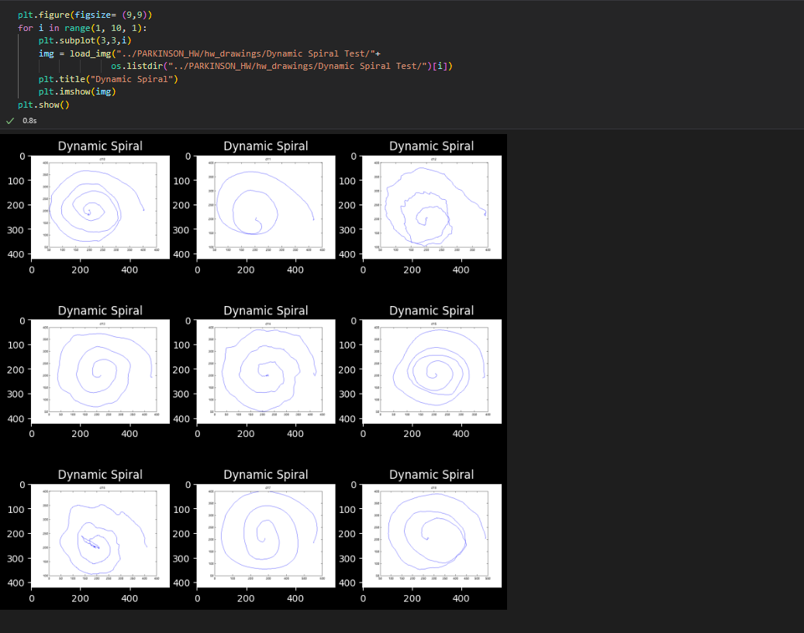

Slide 11
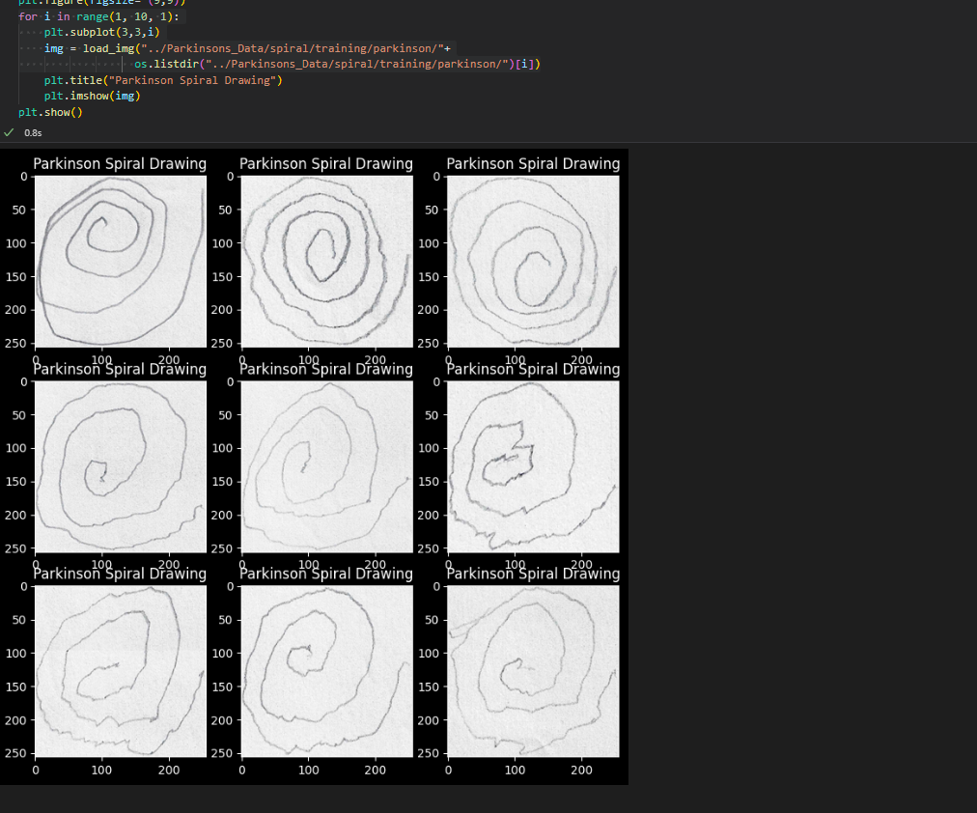
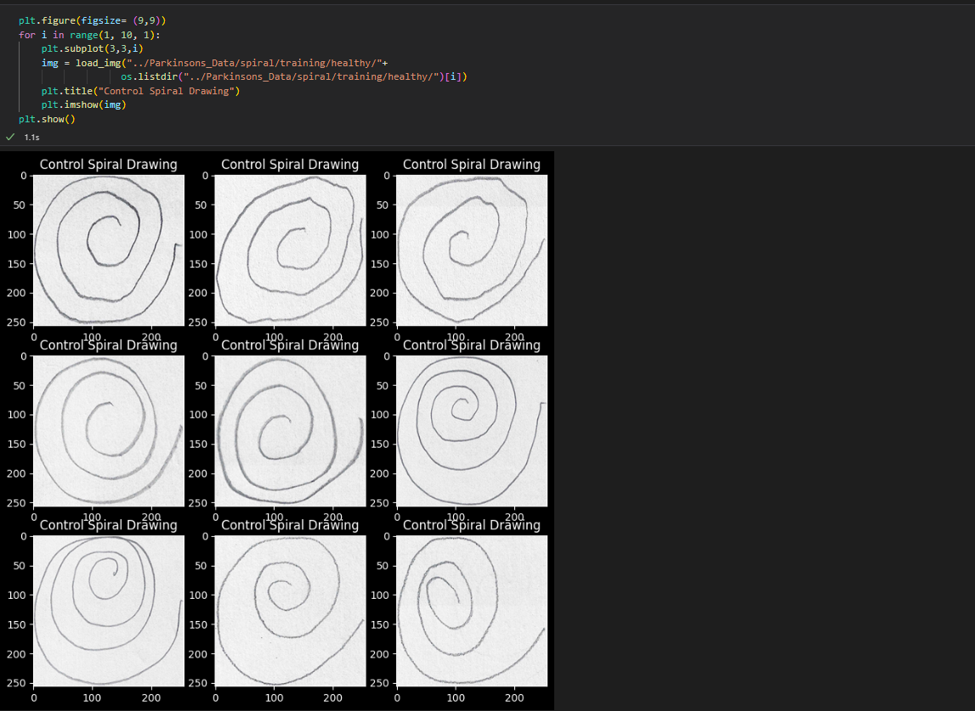

Slide 12
Data
The data is mostly comprised of labeled images either labeled as control or labeled as Parkinson's
The second data set is made up of images but also has corresponding csv files that indicate the amount of time taken to draw and the amount of pressure on the pen for each image.

Slide 13
Application
The use of machine learning in Classifying and predicting whether certain drawings indicate Parkinson can be used as a benchmark for the development of Parkinson and help professionals determine the severity in less time.
A goal of this project would be to have a working application in which a questionnaire can be answered and a photo can be uploaded of a drawing and it will give diagnosis.

Slide 14
Citations
1.
Nackaerts E, Broeder S, Pereira MP, Swinnen SP, Vandenberghe W, Nieuwboer A, Heremans E. Handwriting training in Parkinson's disease: A trade-off between size, speed and fluency. PLoS One. 2017 Dec 22;12(12):e0190223. doi: 10.1371/journal.pone.0190223. PMID: 29272301; PMCID: PMC5741263.
2.
Thomas M, Lenka A, Kumar Pal P. Handwriting Analysis in Parkinson's Disease: Current Status and Future Directions. Mov Disord Clin Pract. 2017 Nov 1;4(6):806-818. doi: 10.1002/mdc3.12552. PMID: 30363367; PMCID: PMC6174397.
3.
Zham, P., Kumar, D. K., Dabnichki, P., Poosapadi Arjunan, S., & Raghav, S. (2017, August 8). Distinguishing different stages of parkinson's disease using composite index of speed and pen-pressure of sketching a spiral. Frontiers. Retrieved February 15, 2023, from https://www.frontiersin.org/articles/10.3389/fneur.2017.00435/full

